Slide 1


Experiment 15
Open-Delta Transformer – Delta-Delta Transformer Comparison
Dr. Norbert Doerry and Dr. John V. Amy Jr.
http://doerry.org/norbert/MarineElectricalPowerSystems/index.htm
© 2025 by Norbert Doerry and John Amy
This work is licensed via: CC BY 4.0 (https://creativecommons.org/)

Slide 2
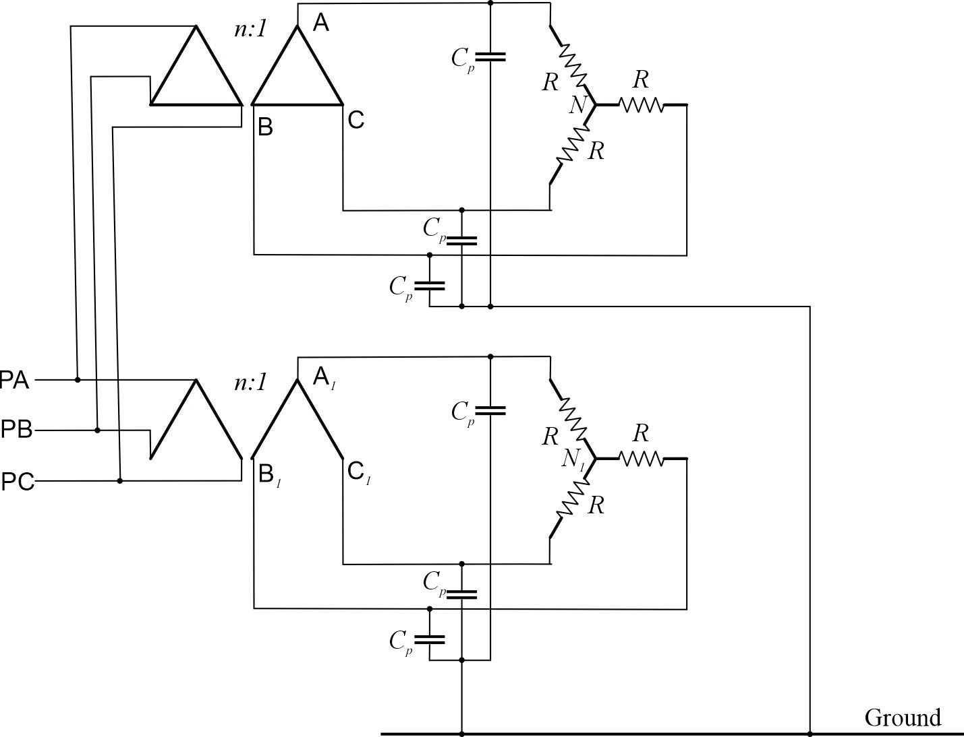
Schematic
C_{p} = 2.2 µF
R = 300 Ω
Common Mode Current Probe
Current Meter (all phases)
Voltage Meter (all phases)

Slide 3
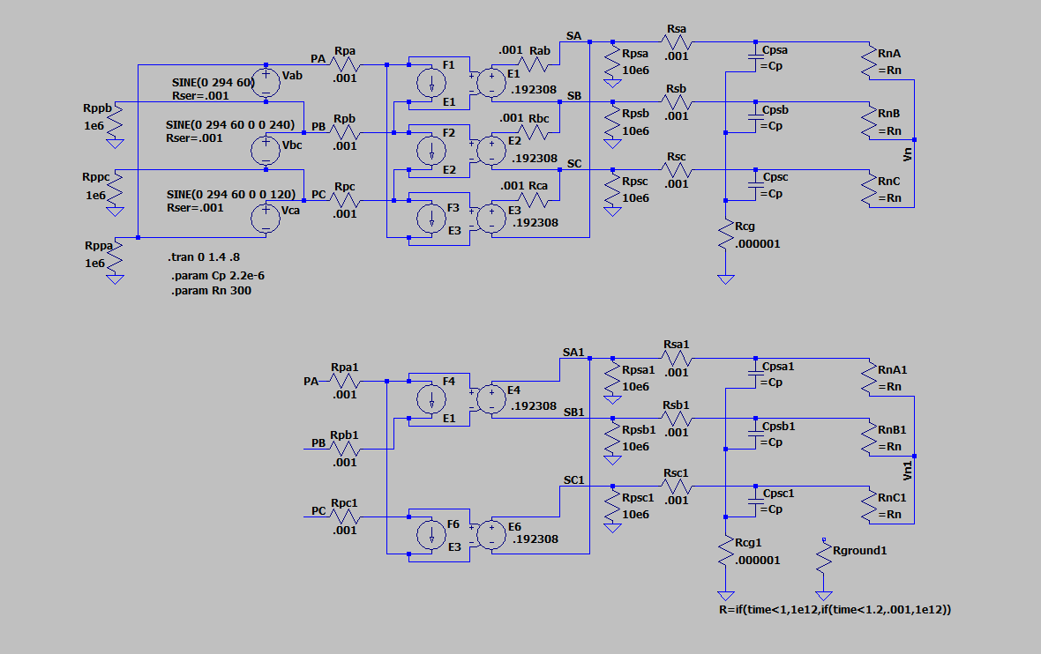
Simulation Model
LTspice
20250207 experiment 15.asc

Slide 4
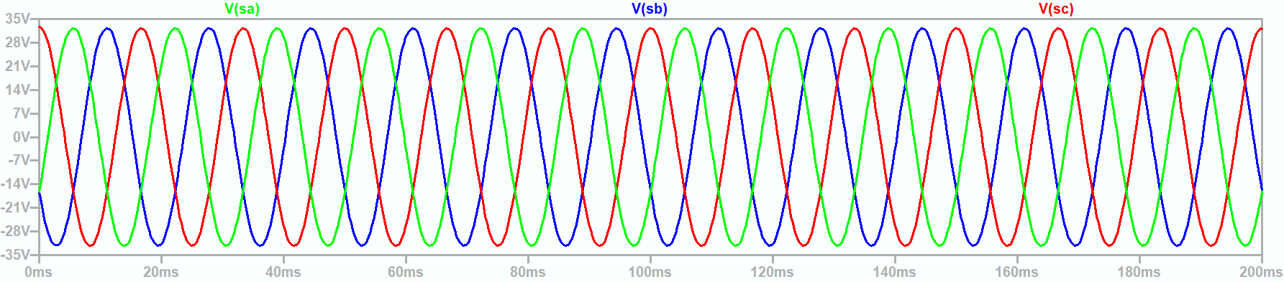
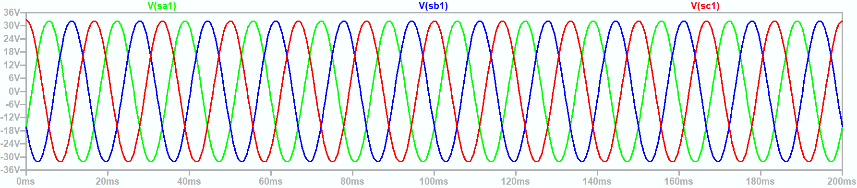
Line to Neutral Voltages identical
Line to Line Voltage are also identical

Slide 5
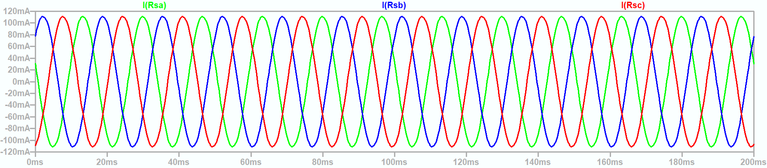

Secondary Phase Currents identical

Slide 6
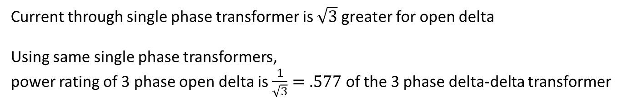
Delta-Delta vs Open Delta single-phase Transformer current
Delta - Delta
Open Delta
60° phase shift
Current through single phase transformer is $\sqrt{3}$greater for open delta
Using same single phase transformers,
power rating of 3 phase open delta is $\frac{1}{\sqrt{3}}=.577$ of the 3 phase delta-delta transformer

Slide 7
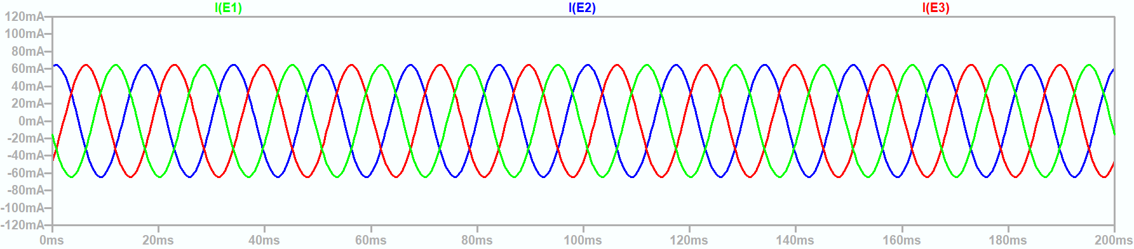
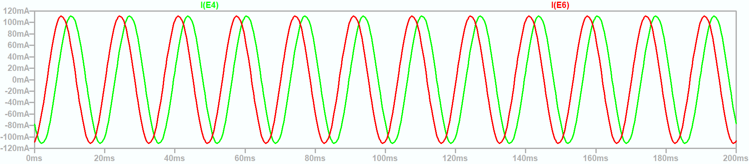
Current through transformer windings not identical
Delta - Delta
Open Delta

Slide 8
Wrap Up

